Slide 1
18ECE220T – Module 4 Cognitive Spectrum Management S – 4, 5, 6, 7
Prepared by
Dr. Diwakar R. Marur
Mr. P. Prabhu--------

Slide 2
S – 4, 5, 6, 7 4. Types of Spectrum & Spectrum sensing 5, 6, 7. Advantages of Spectrum sensing & Disadvantages of Spectrum sensing

Slide 3
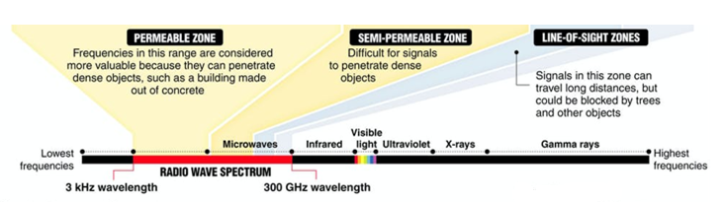
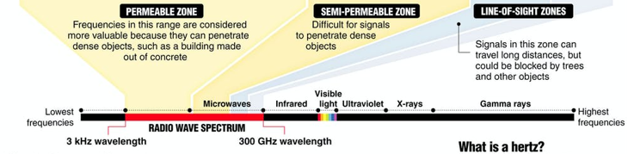
RECAP: Spectrum (1/4)

Slide 4
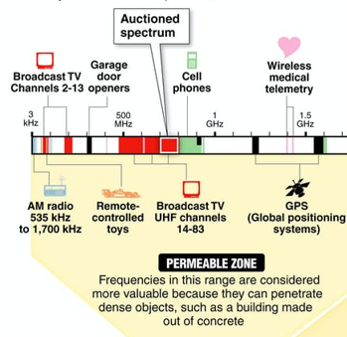
RECAP: Spectrum (2/4)
Image Courtesy: Reference [2]

Slide 5
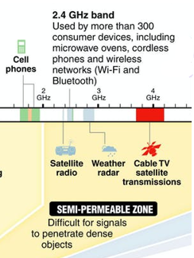
RECAP:
Spectrum (3/4)
Image Courtesy: Reference [2]

Slide 6
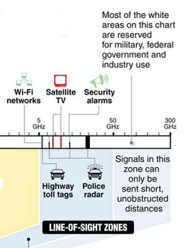

RECAP:
Spectrum (4/4)
Image Courtesy: Reference [2]

Slide 7
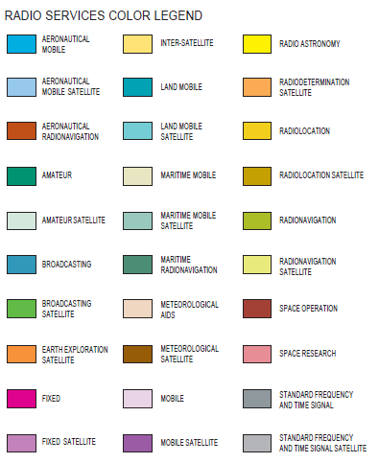
RECAP: Radio Services
Image Courtesy: US Dept. of Commerce

Slide 8
Spectrum Sensing
A key requirement for cognitive radio is spectrum sensing, i.e., detecting the presence of other users.
Spectrum Sensing is important, in a hierarchical CR, where the secondary devices are obligated to avoid interference to primary users.
Spectrum sensing gives information for spectrum sharing also.
Interference at a specific RX is often characterized by the interference temperature, which describes the interfering Power Spectral Density (PSD) divided by Boltzmann’s constant kB.

Slide 9
Solution 1
Key problem is one can sense only transmitted radiation.
A completely passive RX is invisible to any sensor. This important dilemma has not been solved
SOLUTION 1. Assume a Transceiver (Tx + Rx) act as primary device.
From transmitted radiation, presence and location of primary device is deduced.
Knowledge on Duplexing policy.
For example a frequency-division duplexing primary transmits in a particular band, the secondary system would know in which band such a primary system device would receive.

Slide 10
Solutions 2, 3
SOLUTION 2. Observe spurious emissions of the primary RX.
For example, the local oscillators of TV RXs are not perfectly isolated from the antenna, and thus their emissions can be observed by the secondary system.
Drawbacks
Observed signal cannot easily be mapped to the location of the RX
It discourages good RX design (i.e., designs that do not have significant spurious emissions).
SOLUTION 3. Assume that primary RXs are in all possible locations where primary transmissions can be heard at a level sufficient for demodulation.
This policy is extremely conservative: RXs that need to be protected are assumed to be within in the coverage region of the primary system.

Slide 11
Solution 4
SOLUTION 4. Let the secondary device start to transmit in any band, and monitor whether the radiation of the primary system changes.
For example, an increase in the transmit power of a primary Code Division Multiple Access (CDMA) TX would indicate that a secondary device is interfering with the primary RX (the primary system increases transmit power in order to keep the Signal-to-Interference-and-Noise Ratio (SINR) constant).
Drawbacks:
it interferes with a primary user,
Changes in the primary TX characteristics due to Secondary interference and due to environment cannot be differentiated
(iii) it does not work in systems that do not change TX characteristics according to interference.

Slide 12
Solutions 5, 6
SOLUTION 5. common control channel that allows dissemination of information about spectrum usage.
This scheme allows highly efficient utilization of the spectrum, but has the drawback that existing devices need to be modified to allow signaling on this channel.
SOLUTION 6. A database that makes geographic locations of primary RXs available to secondary systems.

Slide 13
Detectors
Detectors are used for sensing, depending on the amount of a priori knowledge that a sensor has about the transmitted waveform.
Energy detection is used when the sensor has no information about the signal structure.
Matched filters provide better performance, but can only be used when the transmit signal waveform is known.
Detection of cyclostationary properties is a compromise solution that does not require knowledge of the waveform, and gives a performance that is somewhat better than that of energy detection. It must be noted that a fully cognitive radio requires a matched-filter detection

Slide 14

1. Energy Detection
No knowledge on transmitted waveform
The sensor measures energy present in the frequency band of interest.
Sensor measures when User Present: - Signal + Thermal Noise
Sensor measures when No User: Thermal Noise
The decision of whether a signal is present or not is thus a classical detection problem that can be formulated as hypothesis testing.
where rn and sn is the received and transmitted signal at time n, and E{|sn|^ 2} = 1and h is the channel gain. Assume is time-invariant.
H0 and H1 are the two hypotheses between which the sensor needs to decide.

Slide 15
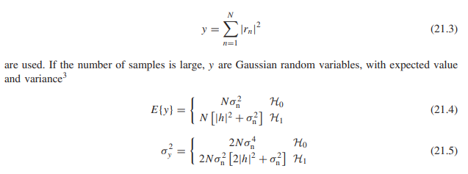
1. Energy Detection (2)
The received signal samples can be averaged over a number of time instances N, so that the decision variables
Source: Reference [1]

Slide 16
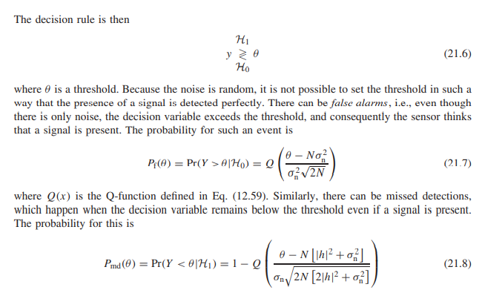
1. Energy Detection (3)
Source: Reference [1]

Slide 17
1. Energy Detection (4)
By adjusting the threshold, trade off between false-alarm probability and missed-detection probability can be carried out.
In a hierarchical cognitive system, the missed-detection probability will usually be prescribed by the frequency regulator
Because a missed detection of the spectrum sensor implies that the secondary system will transmit even though a primary user is active in the considered band.
How many sensing values N should be obtained before a decision is made
CASE 1: N is too small, then the decision variable has a large variance, and a high Pf (or Pmd) must be accepted.
CASE 2: N is too large, the decision process takes too much time, reducing the spectrum usage and increasing the chance that the primary system starts to transmit.
This problem can be treated by means of “optimum stopping theory.”

Slide 18
2. Matched Filter
In this case sensor knows the transmitted waveform.
If transmitted waveform known then, matched filtering is the best way of improving the Signal-to Noise Ratio (SNR) of the detection process.
For a spectrum-sensing cognitive radio, the output of the matched filter is used as a test statistics to detect whether signal energy is present in the considered band or not.
A fully cognitive radio might have to demodulate/detect the symbols transmitted by the primary user.
In some circumstances, a sensor might want to detect/decode only pilots or beacons, since those have usually better SNR than the actual payload data, and might also contain information about spectrum usage (e.g., the duration of a packet) that can be exploited by a secondary system.

Slide 19
Cyclostationary & Wavelet Detection
Modulated signals usually have cyclostationary statistics, i.e., certain statistical properties are periodic.
This fact can be employed to enhance the performance of an energy detector. In other words, the incoming signal is correlated with itself before being sent to an energy detector.
Wavelet Detection If the PSD of the signal that is to be detected is smooth within a frequency band but shows steep decay at an edge, a wavelet transform can expose the edges of the PSD.
The drawbacks of this technique are the high computational costs and the fact that the method does not work well for spread-spectrum

Slide 20
Multinode Detection
In many cases, the secondary system consists of multiple nodes, which then have the possibility of helping each other reach a better sensing decision.
Here each of the secondary nodes listens and makes an independent decision whether channel is occupied.
The nodes then exchange this binary information, and come to a joint (“fused”) decision as to whether the spectrum is available or not.
Even if one node sense occupation, the secondary system decides the channel is occupied.

Slide 21
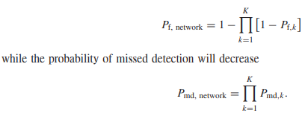
Multinode Detection (2)
Clearly, the overall false-alarm probability increases, becoming
Source: Reference [1]

Slide 22
Spectrum Sensing - Classification
Spectrum Sensing
Non-Cooperative
Co-operative Sensing
Interreference Based
Source: Reference [3]
Spectrum Sensing
Narrow-band
Wideband
Source: Reference [4]

Slide 23
1. Non-cooperative Sensing
Non-cooperative Sensing: Otherwise called as Transmitter detection.
Each cognitive radio has the ability to detect the presence and absence of Primary User (PU) in the specified spectrum space.
Methods in Non-cooperative sensing technique are
Energy Detector Based Sensing
Waveform based sensing
Cyclostationary Based Sensing
Match Filtering
Eigen value based Sensing

Slide 24
1. Non-cooperative Sensing (2)
Advantage
Simple System
Disadvantages:
It suffers from multipath fading.
The received signal strength and the hidden terminal problem can lead to incorrect spectrum utilization.
Satisfactory performance can be achieved through longer observation time.

Slide 25
2. Cooperative Sensing (CS)
Control channels are used to share the spectrum sensing result.
CS otherwise called as receiver detection technique.
CS gives solutions to the following problems
noise uncertainty, fading and shadowing. Next, it decreases the probability of misdetection and false alarm, solves hidden primary user problem and it decreases sensing
CS Types
Centralized sensing g time.
Distributed sensing
External sensing

Slide 26
2. Cooperative Sensing (2)
Advantage
Reduced false alarm rate.
Hidden node problem is sufficiently reduced.
Signal detection is more accurate.
Increased in agility.
Disadvantage
Control Channel
System Synchronization
Suitable geographical spread of cooperative nodes.
The increased number of terminals leads to a increase in the cost.

Slide 27
3. Interference Based
In this method secondary storage is allowed only if it does not degrades the primary user (PU) Quality of service below a tolerant limit.
Each primary user has an interference temperature limit that defines tolerate to guarantee certain quality of service.
Cognitive radio will measure the interference environment and adjust their transmission such that the interference to PU is not above the regulatory limits.
Advantage: Full protection to Primary User
Disadvantage: To measure the interference temperature at the primary receiver which is unfeasible.

Slide 28
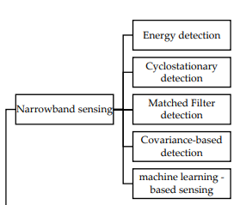
Narrowband Sensing
Source: Reference [4]

Slide 29
Narrowband Sensing
Sensing Technique | Advantage | Disadvantage
1. Energy detection | • Easy to implement • No prior knowledge of the primary signal characteristics is required | • High false alarm rate • Unreliable at low SNR values • Sensitive to noise uncertainty
2. Cyclo-stationary feature detection | • Robust against noise uncertainty • Distinguish between signal and noise • Decreased probability of false alarm at low SNR | • Large sensing time to achieve a good performance • High energy consumption when the size of the samples is large
3. Matched Filter based detection | • Better detection at low SNR region • Optimal sensing | • Prior knowledge of the primary user signal is required • Impractical since prior knowledge about the signal is not always available

Slide 30
Narrowband Sensing (2)
Sensing Technique | Advantage | Disadvantage
4. Covariance-based detection | • No prior knowledge of the primary user signal and noise is required • Blindly detection | • Good computational complexity coming
5. Machine learning based spectrum sensing | • Machine learning can detect if trained correctly can be a good approach • Minimize the delay of the detection • Use complex model in an easy manner | • Complex techniques • Has to be adapted in learning in very fast changing environments • Features selection affects detection rate and adds complexity • High dataset has to be build

Slide 31
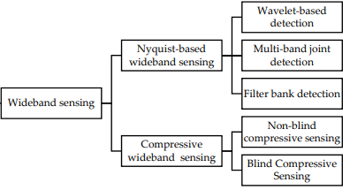
Wideband Sensing
Source: Reference [4]

Slide 32
Wideband Sensing
Broadband communication systems requires high data rates and therefore high bandwidth.
Thus secondary users need to sense wide frequency ranges of the radio spectrum to find the best available channels.
Approaches to perform wideband spectrum sensing
Divide the spectrum into several Narrow Bands (NB) and perform sensing sequentially, a process that increases sensing time.
Sense the NBs in parallel by using multiple sensors and performing joint detection. This approach results in high the hardware cost and the fact that sensor synchronization is required.
compressive sensing techniques to reduce the number of samples, reducing the sensing delay.

Slide 33
Wideband Sensing (2)
Nyquist Wideband Spectrum Sensing:
Conventional wideband spectrum sensing techniques use standard ADC converters operating at the Nyquist rate to sample the wideband signal.
Types: wavelet, multi-band joint detection, and filter bank sensing.
Sub-Nyquist Wideband Sensing:
Otherwise called as Compressive Sensing. Sample signals below the Nyquist rate
Types: analog-to-information converter-based (AIC), two-step sensing, adaptive CS, and geo-location based CS.

Slide 34
Nyquist Wideband Spectrum Sensing
Sensing Technique | Advantage | Disadvantage
Wavelet | • Reduced latency compared to single band detection | • Unaffordable sampling rate • High latency • High energy consumption • High complexity
Multi-band joint detection | -- Same as above -- | -- Same as above --
Filter bank | Reduced latency compared to wavelet-based sensing techniques | -- Same as above --

Slide 35
Sub-Nyquist Wideband Sensing:
Sensing Technique | Advantage | Disadvantage
AIC | • Reduced number of measurements compared to Nyquist- based sensing techniques | • Number of measurements to be used is not specified • Reduced performance compared to non-compressed techniques
Compressive sensing with recovery | • Discrete Cosine Transform is more accurate than Discrete Fourier Transform • Reduces processing time | • Higher complexity and reduced performance compared to non-compressed techniques in terms of probabilities of detection and false alarm • Estimation of sparsity level is needed

Slide 36
References
Andrea Molish, “Advanced Wireless Communications: Principles and Practice”, Cambridge University Press.
Wireless spectrum is for sale ... but what is it? | https://theconversation.com/wireless-spectrum-is-for-sale-but-what-is-it-11794
A. Arthy and P. Periyasamy, A Review on Spectrum Sensing Techniques in Cognitive Radio Network, Int. Journal. of Advanced Networking and Applications (IJANA), 2015.
Youness Arjoune and Naima Kaabouch, “Comprehensive Survey on Spectrum Sensing in Cognitive Radio Networks: Recent Advances, New Challenges, and Future Research Directions”, Sensors, Jan, 2019.

Slide 37
Thank You

